Slide 1
TIMEX
TimeSeries Forecasting a.a.S

Slide 2
01
COMPONENTS

Slide 3
Web Application
Manager
Data Ingestion
Prediction
Validation
Receives the clients .json configuration files
Asks the Manager for starting the forescasting workflow
Displays the results to the client
Manages the requests coming from the timex_app:
calls the data_ingestion_module to load the dataset
performs async http requests to the predictor. Payload = [ loaded_dataset, .json config_file ]
sends the model(s) results to the validation component
sends the best model results back to the web application
Creates a pandas DataFrame from a .csv file. The URL to the dataset is provided inside the user .json file
Performs some data preprocessing required for the analysis
Computes training of the model(s)
Chooses the best models based on the main accuracy estimator specified in the user .json file.

Slide 4
Example of .json configuration file
{
"activity_title": "Bitcoin price forecasting",
"verbose": "INFO",
"input_parameters": {
"source_data_url": " ... ",
"columns_to_load_from_url": "Date,Close",
"datetime_column_name": "Date",
"index_column_name": "Date",
"frequency": "D"
},
"model_parameters": {
"possible_transformations": "none,log_modified",
"models": "fbprophet,arima",
"main_accuracy_estimator": "rmse"
},
"visualization_parameters": { ... }
}

Slide 5
02
Workflow

Slide 6

Notice:
the parameter configuration file is a json
the python classes, such as data frames or model results, are passed among the module using the pickle format

Slide 7

03
Docker Containers

Slide 8
Python:3.9-slim-buster
(Docker base Image)
Timex_manager
Timex_utils
Timex_data_ingestion
Contains utility functions and libraries dependencies shared among the children
(Manager Component Container)
(Data ingestion Component Container)
Timex_predictor
Timex_app
Timex_validator
(Predictor Component Container)
(Web Application Container)
(Validation Component Container)

Slide 9
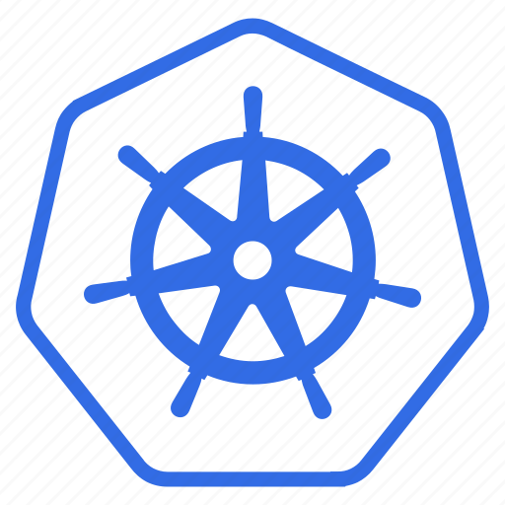
04
Kubernetes

Slide 10
4 PODS
POD - 1
POD - 2
POD - 4
Timex Web App
Manager - Validator
Timex Predictor
POD - 3
Timex Data Ingestion

Slide 11
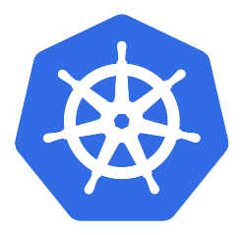
IN DEPTH
POD - 1
POD - 2
S
E
R
V
I
C
E
S
E
R
V
I
C
E
Timex_app
Timex_Validator
Timex_Manager
S
E
R
V
I
C
E
POD - 3
POD - 4
S
E
R
V
I
C
E
Timex
data_ingestion
Timex_predictor

Slide 12
Further Information
3 replicas for the predictor POD
1 replica for each of the other PODs
Communication among containers in different PODs performed through SERVICES
Communication among containers in the same POD performed through LocalHost

Slide 13
NEXT STEPS
Deploying on Amazon AWS
Testing Different Configurations
Finding the Bottlenecks
Dataset:
https://archive.ics.uci.edu/ml/datasets/ElectricityLoadDiagrams20112014

Slide 14
THANKS

